Slide 1

Exam AZ-303: Microsoft Azure Architect Technologies Crash Course
Tim Warner

Slide 2


Tim Warner
Based in Nashville, TN, US
MCT, MVP
Twitter: @TechTrainerTim
Badge: timw.info

Slide 3
Course Materials
timw.info/az303

Slide 4
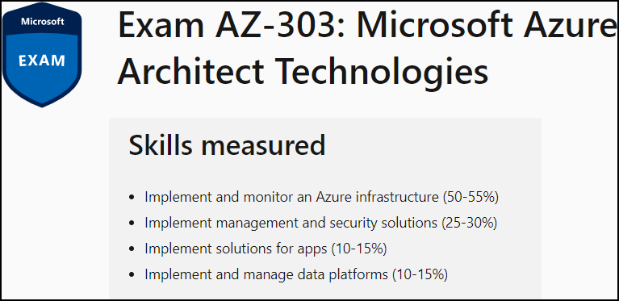
Learning Goals
Day 1
Day 2

Slide 5
Setting Expectations
Azure Architect is an expert-level certification
You should already know how to deploy and configure Azure resources
This is a "crash course"
Please plan to review these materials more than once
Recording takes ~24 hours to process
Five-minute break at midpoint
Please ask/answer questions and provide feedback in the Q/A panel, not the group chat

Slide 6
2020 Exam Update Information
Microsoft Worldwide Learning (WWL) revisits the Azure role-based certs yearly
Relevant blog post: timw.info/az2020
AZ-303 is available now
AZ-300 retires around September 30, 2020

Slide 7
Tim's Certification Study Pyramid
Interdependence
Content knowledge
Practical application
Test-taking skills

Slide 8
Authentication

Slide 9

Hybrid Identity

Slide 10

Passthrough Authentication

Slide 11

Seamless Single Sign-on

Slide 12
Azure Storage

Slide 13
Storage Account Replication
1
3
3
2
LRS
ZRS

Slide 14
Storage Account Replication
1
3
1
3
2
2
GRS – RA/GRS

Slide 15
Azure Compute

Slide 16
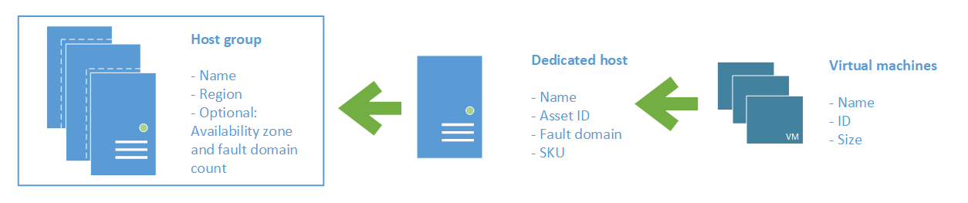
Azure VM Dedicated Host

Slide 17
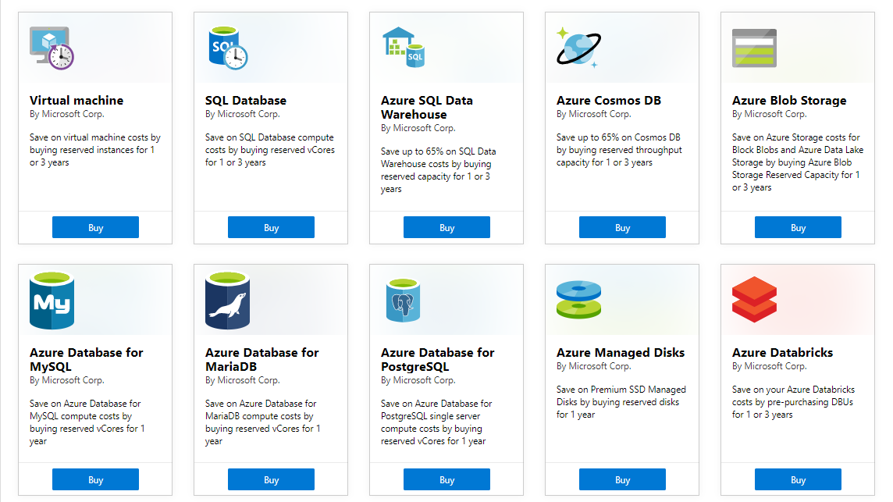
Azure Reservations

Slide 18

VM Scale Sets

Slide 19
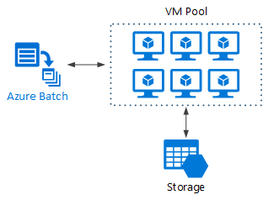
Azure Batch

Slide 20

Availability Set

Slide 21

Availability Zone

Slide 22

Hybrid Networking

Slide 23

VNet Peering

Slide 24

Network Virtual Appliance

Slide 25

Load Balancing

Slide 26

Azure Load Balancer

Slide 27

Application Gateway

Slide 28

Traffic Manager

Slide 29

Front Door Service

Slide 30

Tenant vs. Subscription

Slide 31
Hybrid Identity

Slide 32

Federated Identity

Slide 33
Module 2 Implement Azure Workloads and Security

Slide 34
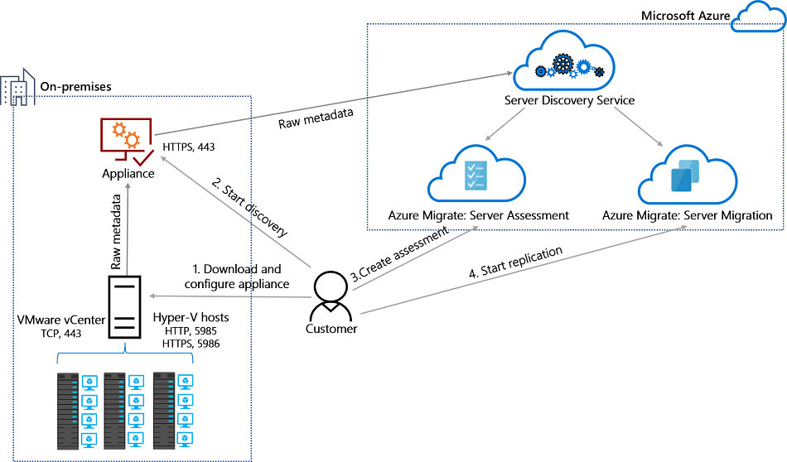
Azure Migrate

Slide 35
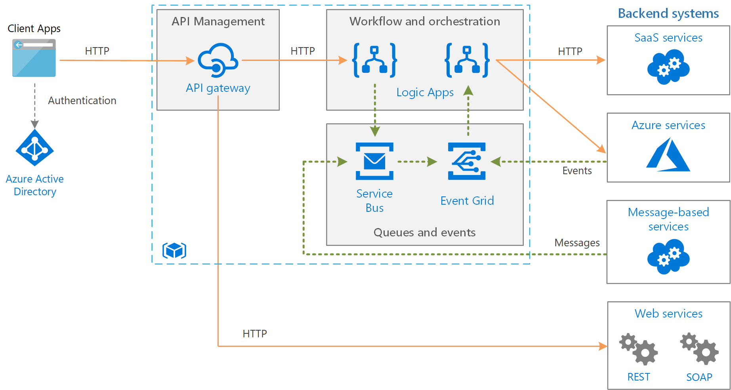
Message-Based Architecture

Slide 36

Azure Management Scopes
/ Tenant Root

Slide 37

Monitoring

Slide 38
Module 3: Create and Deploy Apps in Azure

Slide 39


Docker Container Lifecycle
https://timw.info/3635f

Slide 40
Module 5: Develop for the Cloud and for Azure Storage

Slide 41
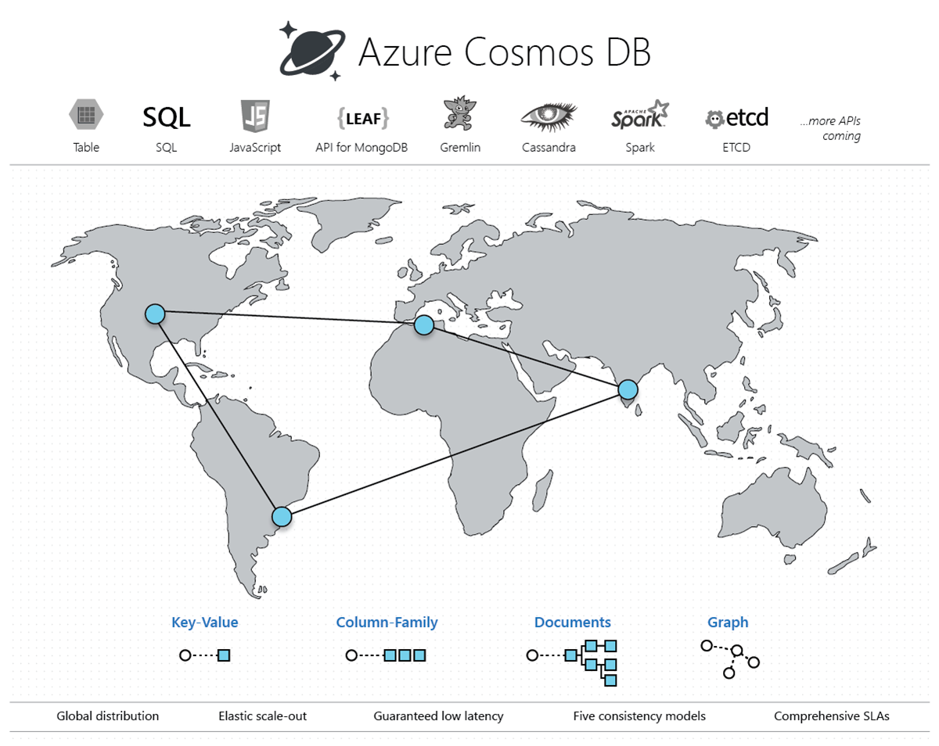
Cosmos DB

Slide 42

Always Encrypted

Slide 43
Module 6: Exam AZ-300 Exam Strategy

Slide 44
Module 6 Learning Objectives
Grasp the content
Acquire the hands-on skills
Master computer-based testing
Comprehend what to expect before, during, and after the exam

Slide 45
Azure Migrate

Slide 46
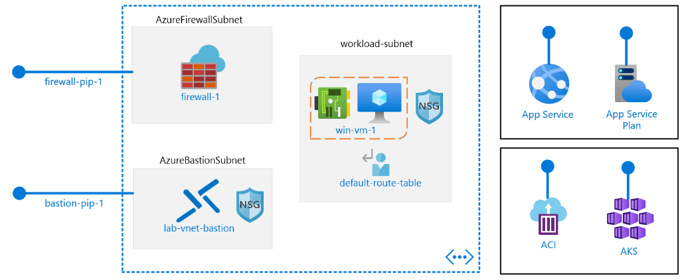
Core Networking

Slide 47
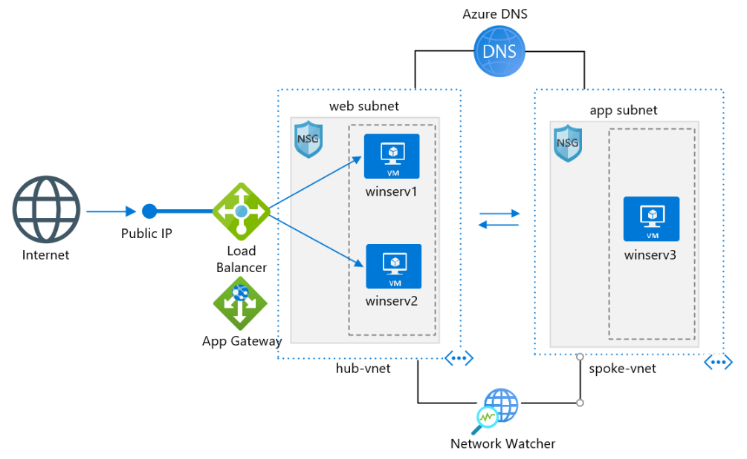
Core Networking

Slide 48
VNet Peering

Slide 49
Load Balancing

Slide 50
Azure Load Balancer

Slide 51
Hybrid Networking

Slide 52
Network Virtual Appliance

Slide 53
Application Gateway

Slide 54
Traffic Manager

Slide 55
Front Door Service

Slide 56
Azure Management Scopes
/ Tenant Root

Slide 57
Docker Container Lifecycle
https://timw.info/3635f

Slide 58

Event Architecture

Slide 59
Cosmos DB

Slide 60
Always Encrypted

Slide 61
Exam AZ-303 Item Types

Slide 62

Multiple Choice

Slide 63
Repeated Scenario
You need to move an Azure VM to another hardware host.
Solution: You redeploy the VM.
Does this solution meet the goal?
Yes
No

Slide 64

Select and Place

Slide 65

Build List and Reorder

Slide 66

Active Screen/Fill in the Blank

Slide 67

Case Study

Slide 68






Performance-Based Lab

Slide 69
Microsoft Online Testing

Slide 70
Microsoft Online Testing Process
timw.info/online

Slide 71

Microsoft Online Testing Process

Slide 72

Microsoft Online Testing Process

Slide 73

Microsoft Online Testing Process

Slide 74

Microsoft Online Testing Process

Slide 75

Microsoft Online Testing Process

Slide 76

Microsoft Online Testing Process

Slide 77

Microsoft Online Testing Process

Slide 78
AZ-303 Exam Strategy/Tips
Focus your skills accordingly:
60 percent Azure portal
20 percent Azure PowerShell
10 percent Azure CLI
10 percent KQL
Expect performance-based labs, but be thankful if you don't see 'em

Slide 79
Thank you!
Course materials: timw.info/az303
Twitter: @TechTrainerTim
Work: timw.info/ps
Web: TechTrainerTim.com

